Slide 1
8 Steps for an Effective Storyboard
By Cristina Rodriguez
Notes:
This presentation will introduce trainers to e-learning storyboards, including the concepts and benefits behind a good storyboard, and how to prepare an effective storyboard in eight steps. With these eight steps and along with a template to get you started, you will have the tools you need to create an effective storyboard.

Slide 2
Introduction
1. Understand the Course Goal
5. Pick a Design Model/ Method
2. Gather and Map Content
6. Choose Design Elements
3. Define Learning Objectives
7. Select an Authoring Tool
4. Create Assessment Criteria
8. Use a Storyboard Template
Notes:
In this presentation I will go over each of the eight steps and share examples of storyboard templates.
Through out my career, I have built a few storyboards and they have been different because the training needs have been varied.
In my experience, a storyboard has been different with every course since the people and the needs are different each time.
This process is adaptive and it should work for your needs.

Slide 3
E-learning storyboard Key points
Documentation
Communication Tool
Purposeful Learning Experience
Notes:
Here are a few key points to explain the concept. I’m going to go over each of them in details.

Slide 4
E-learning storyboard Key points
Documentation
Course Material
Structure
Interactivity
Functionality
Notes:
Documentation
A storyboard allows us to document our thoughts of course material, structure, interactivity, functionality for an e-learning training. It is a spec document that will have images, transcripts, and developer notes.

Slide 5
E-learning storyboard Key points
Communication Tool
Client
How can you
know?
SME (Subject Matter Expert)
Instructional Designer
Developer
Notes:
Communication
So how can you as the trainer?… Know what the client wants? How to it will work online? And how it should be delivered, if you don’t all communicate.
The concept is to have a document that can be an effective communication tool to share between the client, SME, instructional designer, and developer. It makes the process of producing an e-learning module more efficient.
A lot of time is wasted on the uncertainty of the final product. There are many roles involved when creating an e-learning course. You have your Client/CEO, SME, developer, LMS administrator, project manager, and you. All these people have to communicate to make an e-learning course successful.

Slide 6
E-learning storyboard Key points
Purposeful Learning Experience
Notes:
Purposeful
Produce a Useful Learning Experience
Positive experience for the learner
Concise training
Doesn’t make the learner feel like they are wasting time.
A storyboard does take time to develop but in the end the learner will have a useful experience.

Slide 7
Benefits
1
Clearly define reference for everyone involved
Efficient way to develop an e-learning course
2
3
Define the best learning model for your audience
Notes:
List of three benefits:
Clearly define reference for everyone involved
Efficient way to develop an e-learning course
Define the best learning model for your audience

Slide 8
STEP 1 Understand the Course Goal
Why are we creating this course?
What outcome do we want?
Notes:
1. Understand the Course Goal
It’s all begins with good communication. You will want to understand the goal and needs of your client.
This is gathered in an initial meeting and it’s helpful to have a questionnaire at hand to ask yourself and your client...Why are we creating this course? What outcome do we want?

Slide 9
STEP 2 Gather and Map Content
Analyze Needs
Identify Required Knowledge
Identify Constraints
Notes:
2. Gather and Map Content
In step 2 you will want to gather and map content. The purpose is to: analyze needs, identify required knowledge, and identify constraints.

Slide 10
STEP 2 Gather and Map Content
Old PowerPoint Presentations
Facilitator Guides
Old Documentation
Outdated Video Trainings
Guided Tours From The SME
Notes:
This phase is discovery time. You will work with your client or SMEs to gather information along with random documents to collect content.
During this time, you will discuss course material with the SME to discover all the necessary content needed to build the training.
For me this has been: old PowerPoint presentations, facilitator guides, old documentation, outdated video trainings, and guided tours from the SME.
Basically, don’t expect to receive the course material in an organized format. It’s more like, a verbal response…”this is what I have explained to someone before.” In this phase, you will want to interview the SME, plus review any material available to grasp the whats and whys of the content.

Slide 11
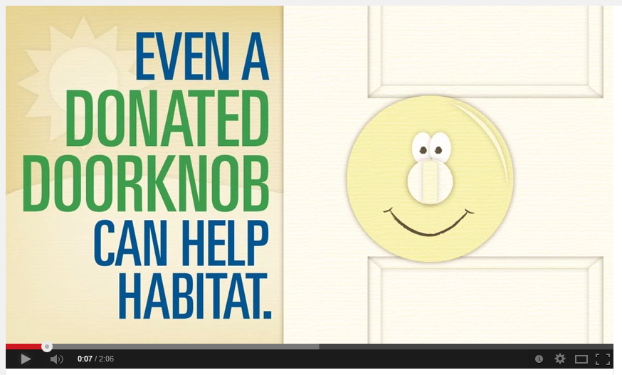
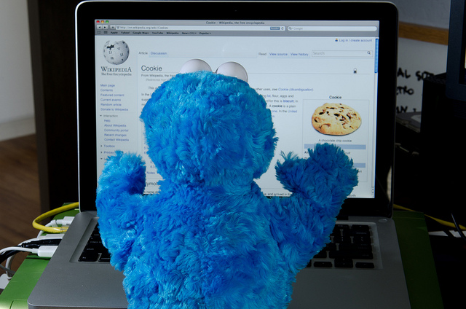
STEP 2 Gather and Map Content
Reviewing the software application
Review Internet or company website
Tour the Intranet
Check out the Social Media
Notes:
You may have to-do your own research by reviewing the application or internet yourself.
For example, if you’re creating an intranet overview. You may have to get access so you can experience what an employee would experience if they toured the internet on their own.
Another way to gather information is doing your own research. It might be as simple as searching the internet if you are working with a company that uses social media.
For example with Habitat for Humanity, when I found out I was going to work on a project for their ReStore new hire training. I went online to find out what the ReStore was all about. While searching, I came across an animated video on YouTube. It explained the concept of how the Restore processed a donation into a benefit for the community. It was adorable. After I meet with the client and received their content materials, I went through the excel sheet and word documents. I then begin to map the content into the storyboard. While going through the material I realized the video would be a perfect addition. After mentioning it to them, they loved the idea and got permission to add to the course.
Image ref: https://www.flickr.com/photos/morozgrafix/5522244036/in/photostream/

Slide 12
STEP 2 Gather and Map Content
What?
Why?
How?
Personal Experiences?
Who is your audience?
What are their needs?
Are there pre-requisite?
Is there a learning curve?
Are there usability constraints?
Notes:
Usually in the gathering process, I or with a team, we'll interview the SME to understand the what, why, how and thoughts. You will want to gather as much as you can learn about the course material, plus find out who is your audience, what are their needs, are there pre-requisite, is there a learning curve, and are there usability constraints?
During this phase, I like to build a course map of the course material. It helps to chunk down the material to bits and pieces that easier to understand. This defines the course material which allows you to work with the SME to add or eliminate necessary material. This will be added to your storyboard and helps develop the next step.

Slide 13
STEP 3 Define Learning Objectives
Upon completion of this continuing education self-study module, the learner is expected to demonstrate enhanced understanding of Laws & Rules of the Board of Nursing. Enhanced understanding will be measured by satisfaction of the following objectives:
Describe the legislative purpose for the Nurse Practice Act.
Verbalize specific laws and rules related to the practice of nursing and nursing assisting.
Identify the pertinent levels of nursing practice in the State and the general scope of practice of each.
Discuss the general requirements for continuing licensure in the State.
Differentiate between ethical and legal practice.
Discuss the process for discipline related to nursing practice.
Create a professional plan for career maintenance and development within the limits of the law.
Our objectives in this course are…
Understand the advantages that come from diversity.
Adopt the 4 Paradigms of the Diversity Advantage.
Achieve higher levels of collaboration in your workplace.
At the end of this module, you will be able to :
Identify the steps to demonstrate leadership.
Define the roles and responsibilities of the Project Manager, Project Engineer, and Lead Engineer.
Recognize the characteristics of a successful project.
Determine the qualities of a effective lead engineer.
What you are about to learn….
Identifing the purpose of the ReStore. Acknowledge ReStore’s role in Habitat’s mission.
Determine the Five P’s in your affiliate store.
Develop Super Agent Restore Skills.
Check out these objective samples.
Notes:
3. Define Learning Objectives
The learning objectives! See these examples.
You’re learning objectives will guide your development process. These are always stated at the beginning of an e-learning course. The format of how it’s worded can vary between long sentences or short sentence that start with a verb.

Slide 14
STEP 4 Create Assessment Criteria
Notes:
4. Create Assessment Criteria
Each learning objective needs to align with the levels of Blooms Taxonomy. This will help you create your quiz questions, knowledge checks or scenarios to assess the learner.
Bloom's wheel, according to the Bloom's verbs and matching assessment types. The verbs are intended to be feasible and measurable.
(Show an example of Blooms Taxonomy chart)
http://en.wikipedia.org/wiki/Bloom's_taxonomy

Slide 15
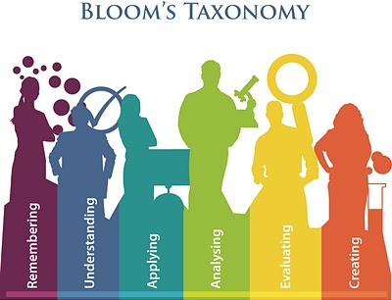
STEP 4 Create Assessment Criteria
Question Format Examples:
True or False
Multiple Choice
Drag n Drop
Fill in the Blank
Hotspots
Notes:
Once you understand your criteria, you can figure out the format for your questions.
Picture ref: http://www.edudemic.com/blooms-taxonomy-to-write-learning-outcomes/

Slide 16
STEP 5 Pick a Design Model/Method
ADDIE
Sam
Knirk and Gustafson
The Action Mapping Process
Gagne’s 9 Principles
Tripp & Bichelmeyer’s Rapid Prototyping
What is a design model that you have used?
Notes:
5. Pick a Design Model/Method
What is a design model that you have used?
To deliver effective e-learning content, pick a theories model to apply to your storyboard.
Such as, ADDIE, Sam, Knirk and Gustafson, The Action Mapping Process, or Gagne’s 9 Principles.
Models are framework that lists generic processes that instructional designers and training developers use. It represents a guideline for building effective training and performance support tools in phases.
(links about the models)
ADDIE
http://www.instructionaldesign.org/models/index.html
Action Mapping Process
http://blog.cathy-moore.com/2012/01/how-action-mapping-can-change-your-design-process/
Knirk and Gustafson
https://www.youtube.com/watch?v=3B33rirBd_g&feature=youtu.be
Tripp & Bichelmeyer’s Rapid prototyping
http://studio.coe.uga.edu/seminars/rpmodel.html
Gagne’s 9 Principles
http://www.nwlink.com/~donclark/hrd/learning/id/nine_step_id.html

Slide 17
STEP 6 Choose Design Elements
Images
Videos
Interaction
Quizzes
Is there content already built and can it be reused?
Notes:
6. Choose Design Elements While working with your client, you’ll understand what type course they may want to produce. Different elements that they may want to include are images, videos, interaction, and quizzes.
Good questions to ask are…
Is there content already built and can it be reused? There is value in older material if it can be used again in a new format.
Can you use repositories? Such as photo stock websites or e-learning content like E-learning brothers where they have layout ideas, images, video and interactions already pre-built.
I have saved a lot of time building my storyboard knowing I had a library of elements that I could choose from. It made the layout process faster.

Slide 18
STEP 6 Choose Design Elements
Manufacture Training
Customer Service Training
Risk Assessment Training
Videos with quiz questions
Case scenarios and knowledge check interaction
Multiple choices branching questions with feedback
Notes:
After considering the previous steps (such as content material and the audience type), you should decide the elements you want to include.
Here are three examples of possibilities that you could come up with.
For a Manufacture Training: you could include Videos with questions that follow.
For a Customer Service training: you could include case scenarios and knowledge check interaction. It would be most effective in example situations.
For Risk assessments training: you could include multiple choices branching questions with feedback.
References:
Design for how people Learn by Julie Dirksen
Michael Allen’s Guide to E-learning by Michael W. Allen

Slide 19
STEP 7 Select an Authoring Tool
Articulate Storyboard
Articulate Studio ‘13
Adobe Captivate 8
Lectora
Calro
Is anyone using an authoring tool they like?
Notes:
7. Select an Authoring Tool
Is anyone using an authoring tool they like?
This one is usually decided by the client because they already have been using an authoring tool. There are many different tools available and you should have an idea of what their best feature qualities are.
Such as Articulate Storyboard, Articulate Studio ‘13, Adobe Captivate 8, Lectora, Moodle, Claro, and list goes on and on.
If you are not familiar with the authoring software, check out some examples so you know what the capabilities are.
(links to features) Articulate
https://www.articulate.com/products/storyline-studio.php
Captivate
http://www.adobe.com/products/captivate/features.html
Lectora Snap
http://elearninguncovered.com/2011/08/review-of-snap-1-1-update/
Claro
http://www.dominknow.com/features.cfm

Slide 20
STEP 8 Use a Storyboard Template
The Final Step!
Notes:
8. Use a Storyboard Template
Now that you gather all this valuable information, your last step is to organize the material and explain your concepts for the course material, structure, interactivity, and functionality.
You can create your own using Powerpoint or use another tool like Articulate Storyline, Mind Maps or drawing apps. But PowerPoint has been a simple tool to use for creating a storyboard. I find most people can open and access the slides pretty easily across different platforms.
Today I’m going to share a template that you can use. It was produced by ELB and available for download at eLearning Brother’s website. This template has everything you will want to include an effective storyboard.
(eLearning Brother’s link)
http://library.elearningtemplates.com/product/19388-ELB-ID-Template/

Slide 21
Screenshot of the E-Learning Brothers
storyboard template
1. Understand the Course Goal
2. Gather and Map Content
3. Define Learning Objectives
4. Create Assessment Criteria
5. Pick a Design Model/ Method
6. Choose Design Elements
7. Select an Authoring Tool
Notes:
Here’s a screenshot of all the powerpoint slides. If anyone can read the slide title for slide 5, you win a prize. Just kidding.
I’m going to go over each of the slides and show you examples.
Just to let you know, the first 7 slides will include all the data that you gathered going through steps 1-7.

Slide 22
Notes:
Project Information: Includes everyone involved in the e-learning course.

Slide 23
Text Here
Text Here
Text Here
Text Here - Location of Style Guide
Text Here (e.g. LMS used, SCORM Standard, Will the course be scored or tracked)
Text Here (e.g. IE8, Firefox, etc…)
Text Here (e.g. Storyline, Captivate, Lectora)
Text Here (e.g. Android, iOS)
Text Here
Text Here
Notes:
Course Design Information: Includes all the specific information the client might want. Fill this information will help the developer know what is be expected and requirements for the course.

Slide 24
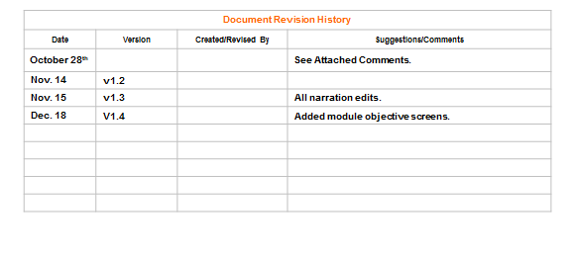
Date | Version | Created/Revised By | Suggestions/Comments
Notes:
Revision History: This is a log of changes that were made or requested. Which happens a lot until the storyboard is just right.

Slide 25
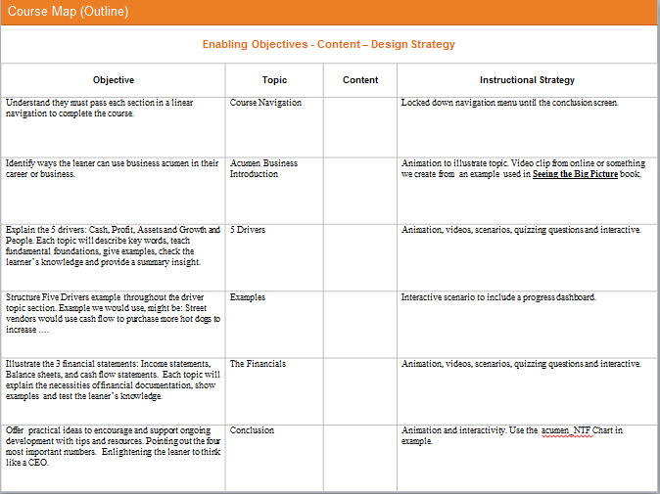
Enabling Objectives - Content – Design Strategy
Objective | Topic | Content | Instructional Strategy
Notes:
Course Map (Outline): I like this slide because it helps with chunking the material into topics. Once that is done you can place your ideas in the Instructional Strategy column. To me when I break down the concepts, my creative juices start flowing and I start to get ideas of the interactive elements I would like to incorporate.

Slide 26
Course Instructional Goal:
Enter goal here
Enter Objective here
Enter Objective here
Enter Objective here
Enter Objective here
1
2
3
4
Enter Sub-Objective here
Enter Sub-Objective here
Enter Sub-Objective here
Enter Sub-Objective here
1.1
2.1
3.1
4.1
Enter Sub-Objective here
Enter Sub-Objective here
Enter Sub-Objective here
Enter Sub-Objective here
1.2
2.2
3.2
4.2
Enter Sub-Objective here
Enter Sub-Objective here
Enter Sub-Objective here
Enter Sub-Objective here
1.3
2.3
3.3
4.3
Notes:
Course Map (Logic Flow): If you have many objectives and sub-objectives, this slide will help to make sure each one is covered in your e-learning course.

Slide 27
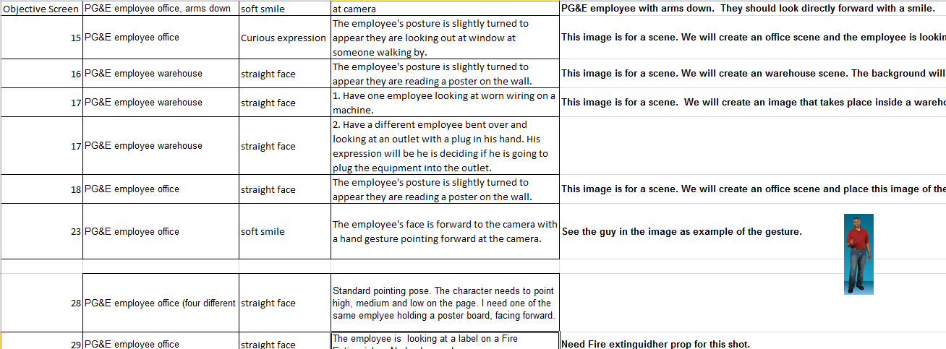
Element | Description | Visual Example
Notes:
Engaging Elements: Here you can add screenshots of templates, images or whatever visuals may be included in the training. Sometime you might want to talk to the SME about the elements. This is a good place to layout them for discussion.

Slide 28
Notes:
Course Branching: This slide will help you to not go bananas! Branching can get complex and this will help you logically see if all the concepts connect. The notes column can include the quiz questions so SME can make sure the right the material is being taught.

Slide 29
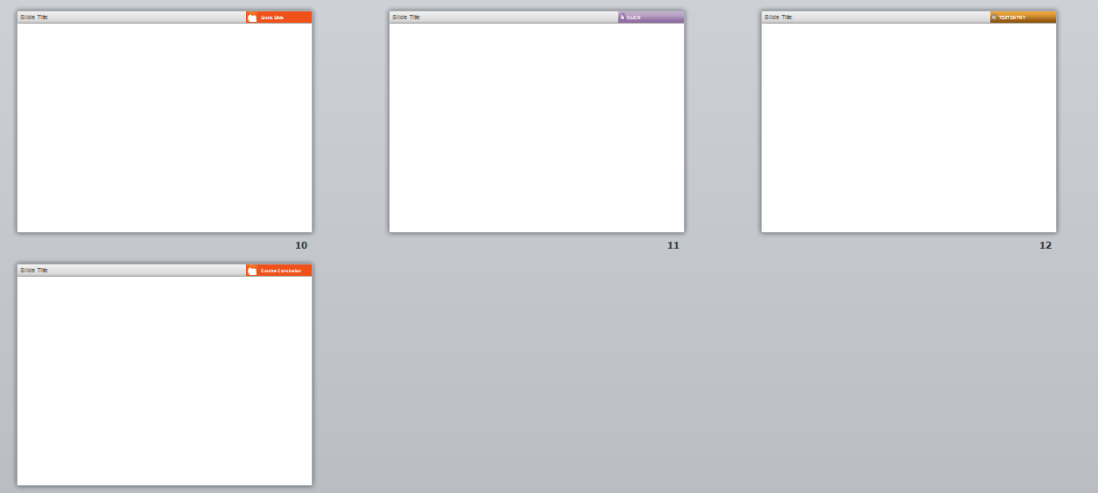
Notes:
Layout: The next five slides are for you to use to create the layouts. There are five because ELB thought of labeling each corner with a title (Introduction, Static Slide, Click, Text Entry, and Course Conclusion)
Most important is what is included on this slide.

Slide 30
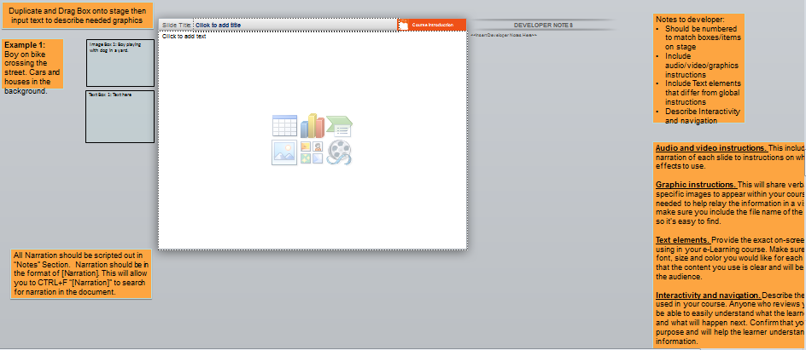
Notes:
This is the powerpoint view that you will see when you open the template. It has designated areas for course material and notes.

Slide 31
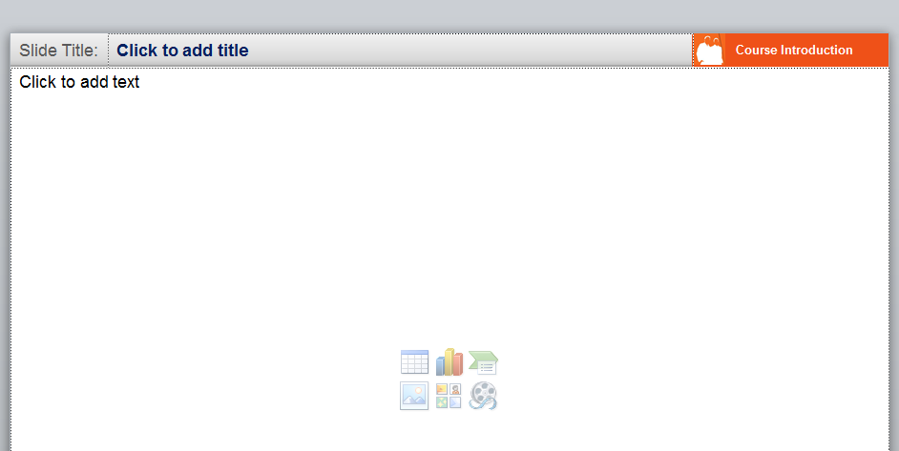
Notes:
Slide Title is the title of slide and can be used for the title that included in the TOC for the e-learning course.

Slide 32
Stage Area
Notes:
The stage area is where you are going to place screenshots of your elements, or box placeholders.
First two are box placeholders and second images are elements

Slide 33
Notes:
To the right of the stage are empty boxes that you can use to place on the stage with descriptions in the middle of the boxes. The SME/developer can use this to find the element.

Slide 34
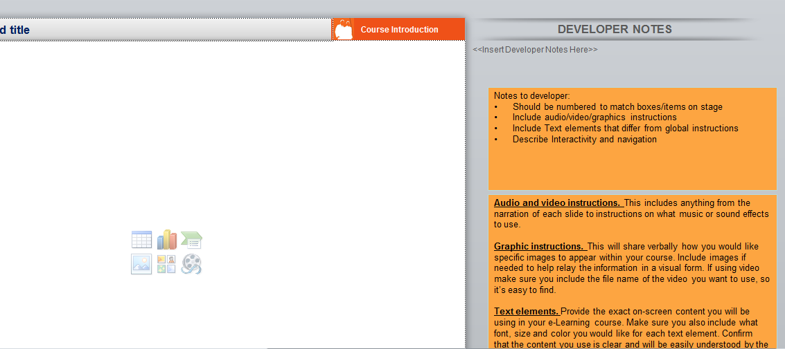
Notes:
To the left of the stage, is the area where you write your notes for the developer. Here you will want to describe what’s going to happen and specific instructions. Instructions will be for how something is going to work or explanation on where to find documents.

Slide 35
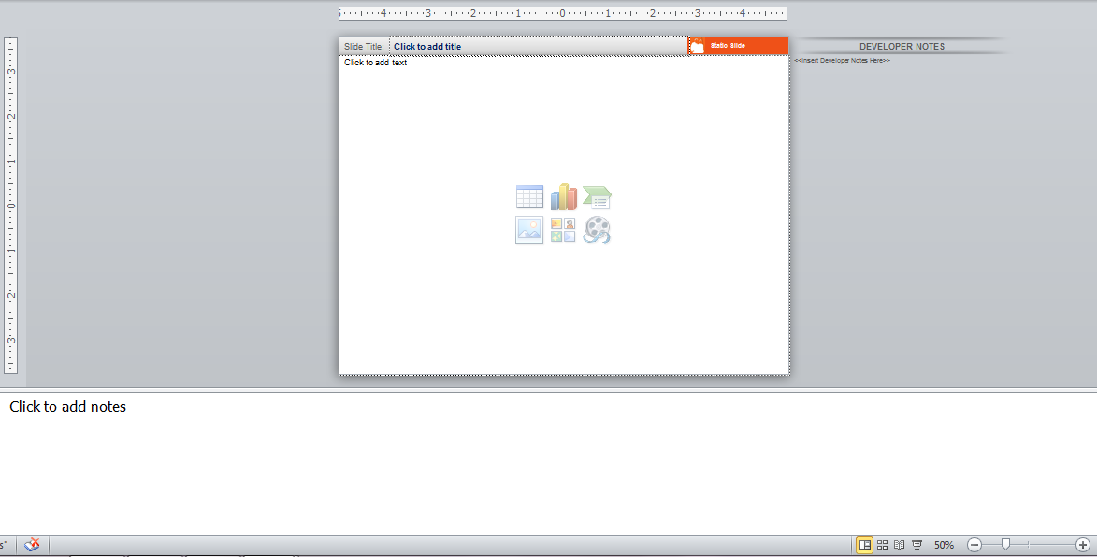
Notes:
Under the stage is where you will place your narration for each slide. This is handy because you can print the Powerpoint in the outline view and you have a script ready to go for copywrite, the client or your voice recording.

Slide 36
Have an awesome experience while you build your e-learning storyboards! Contact information: cmrmediamama@gmail.com www.linkedin.com/in/cmrmediadesign www.cmrmediadesign.com
Notes:
Have an awesome experience while you build your e-learning storyboards!
Cristina Rodriguez Contact information:
cmrmediamama@gmail.com www.linkedin.com/in/cmrmediadesign/
www.cmrmediadesign.com

